Slide 1


Data Integration with Python

Slide 2
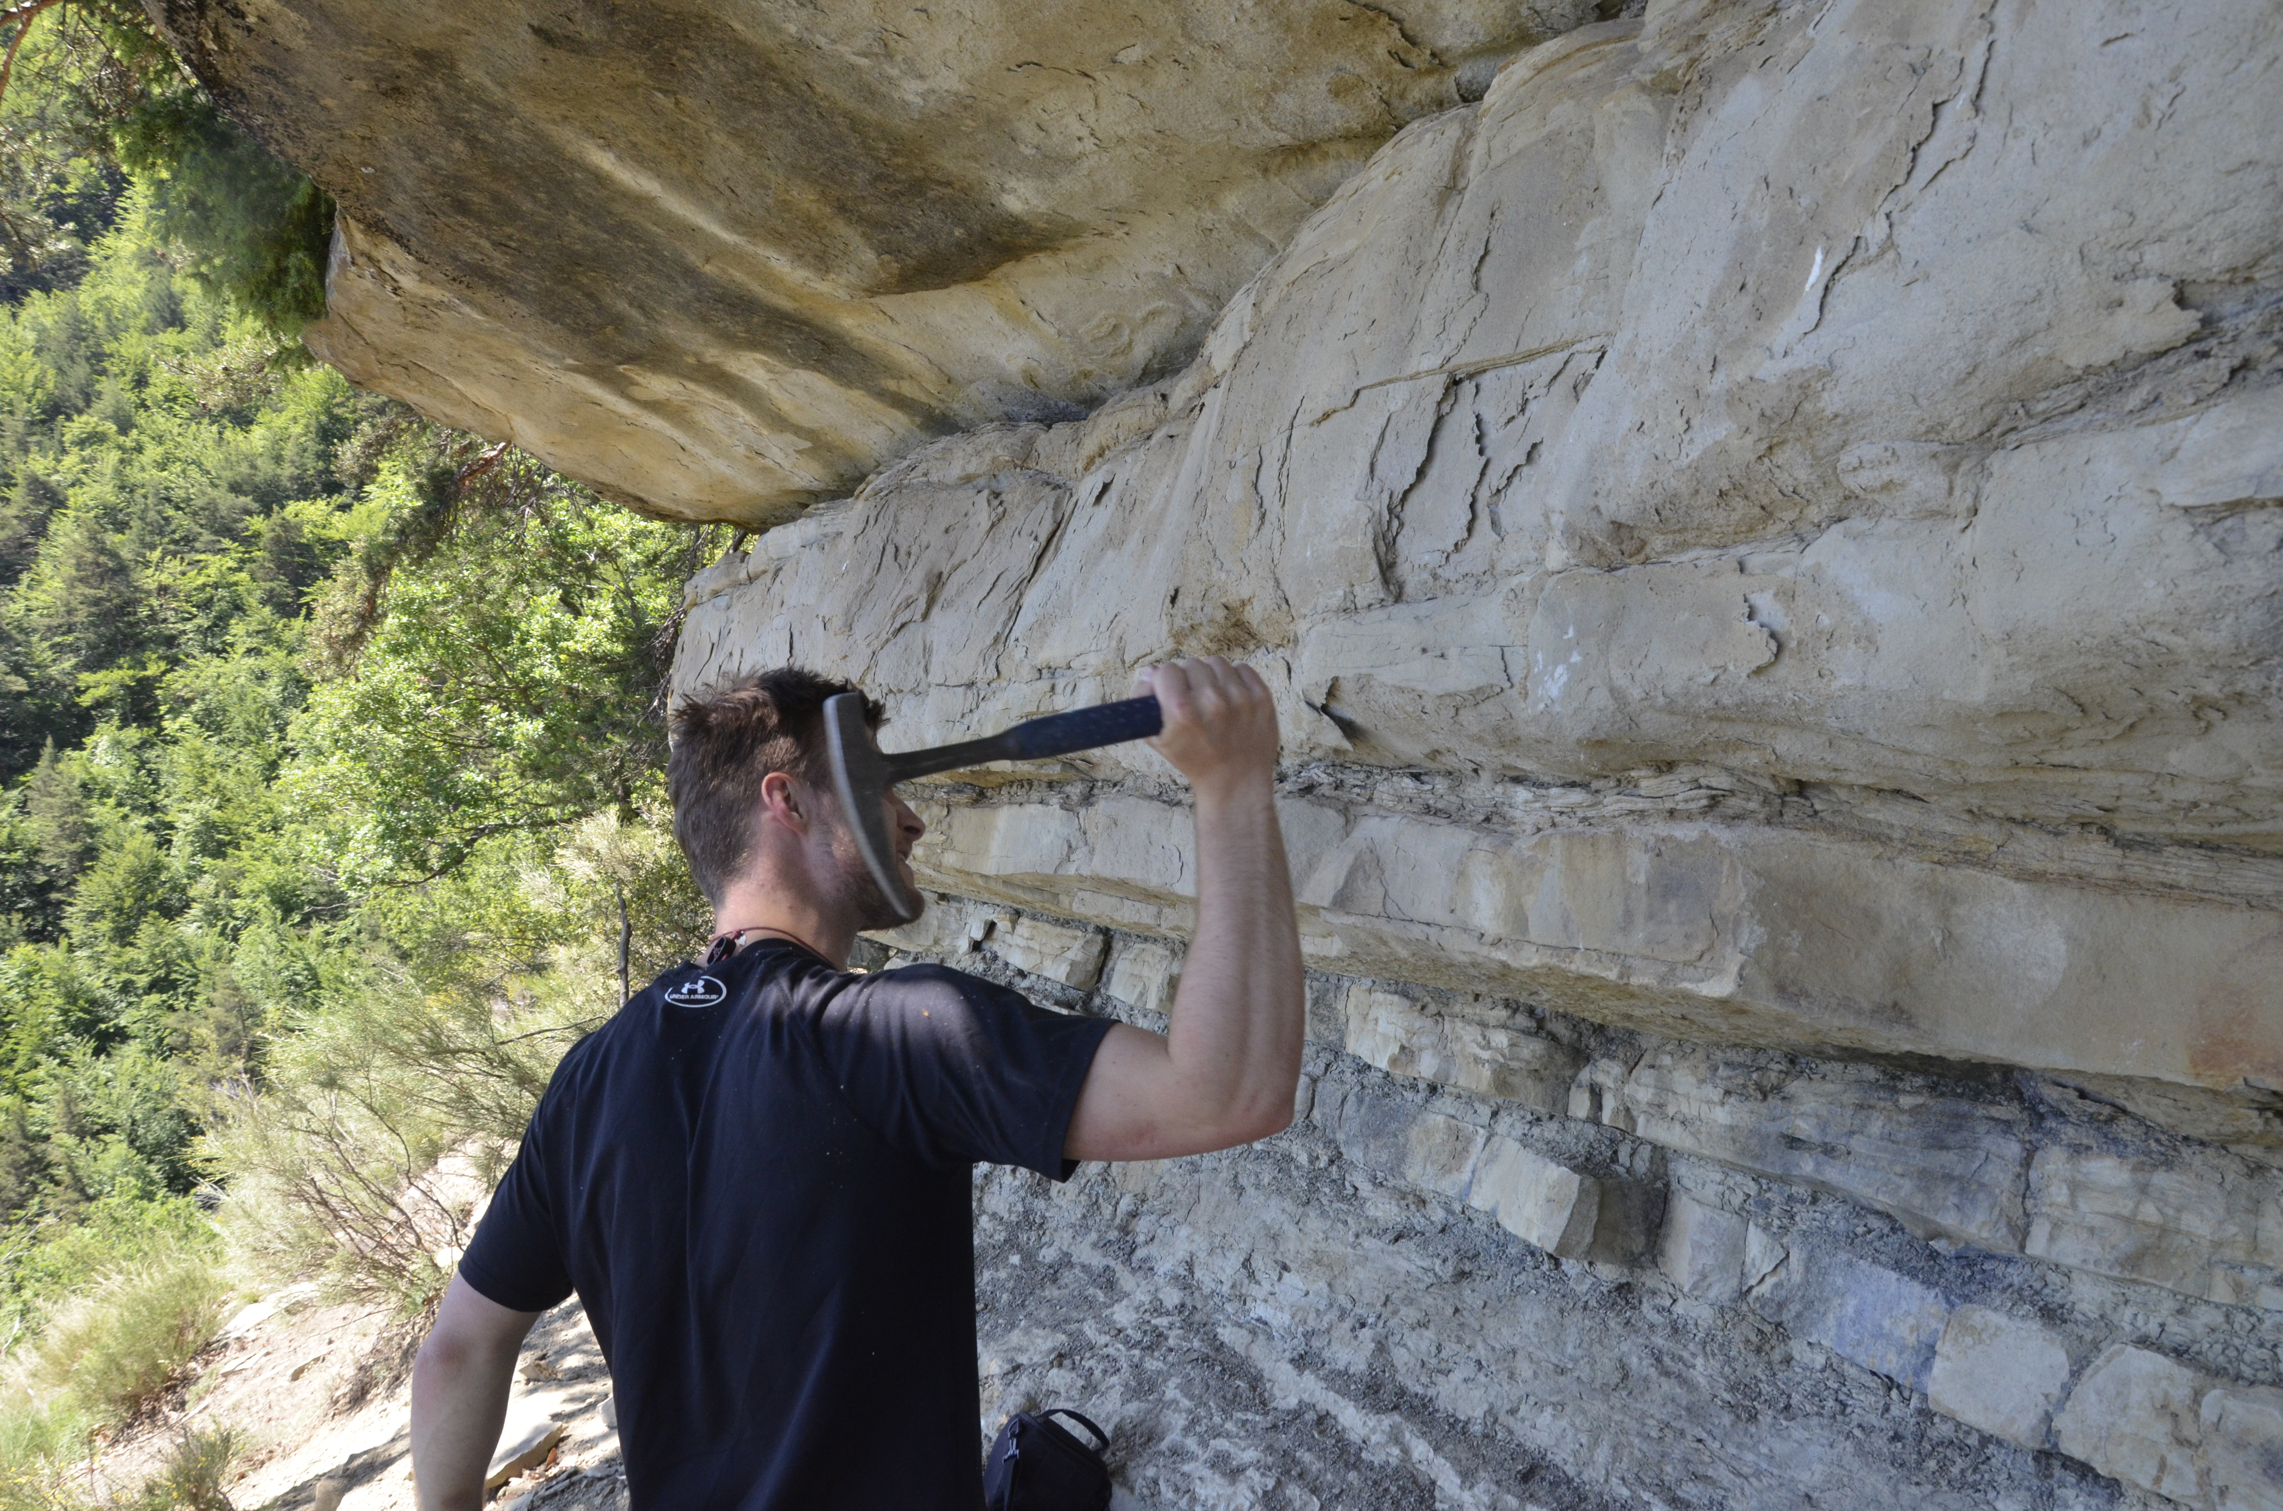
Me
Euan
BSc – Glasgow
PhD & postdoc – Manchester
CLASS Fellowship – BOSCORF
Primarily a field geologist
Started learning Python during my PhD
Use Python almost daily now for my own research, and learn something new every day

Slide 3
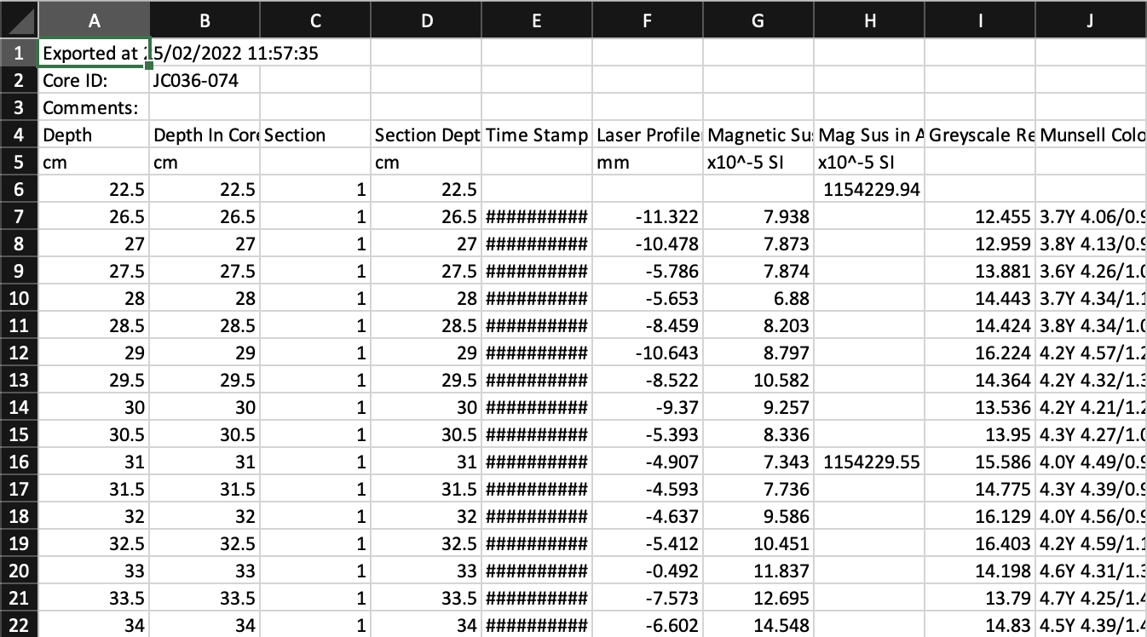
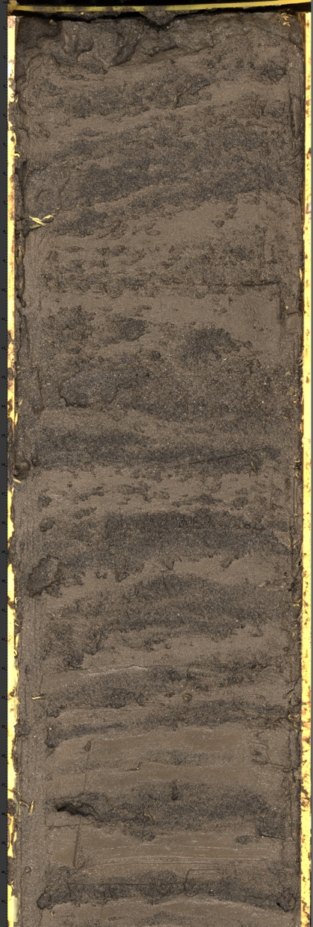
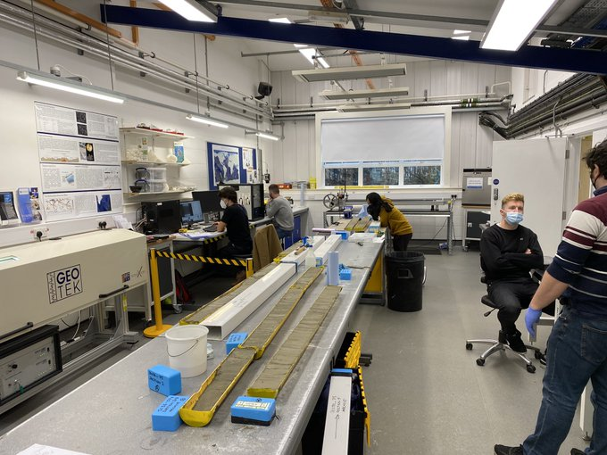
Scope and Plan
Intro to data integration with Python using typical data collected at BOSCORF
Images
X-ray
XRF
Primary aims are that by the end you will:
See how useful Python can be for handling core data generated at BOSCORF
See how useful Python can be for your own general work
Want to learn more

Slide 4





Scope and Plan
We will work through one exercise today, but there are three others available:
Python basics
Libraries and modules
Geoscience example
The Binder links will be open permanently so feel free to leave and come back to the notebooks and exercises whenever you want
There is also a guide for downloading Python to your own machine and some ‘cheatsheets’

Slide 5
Example

Slide 6
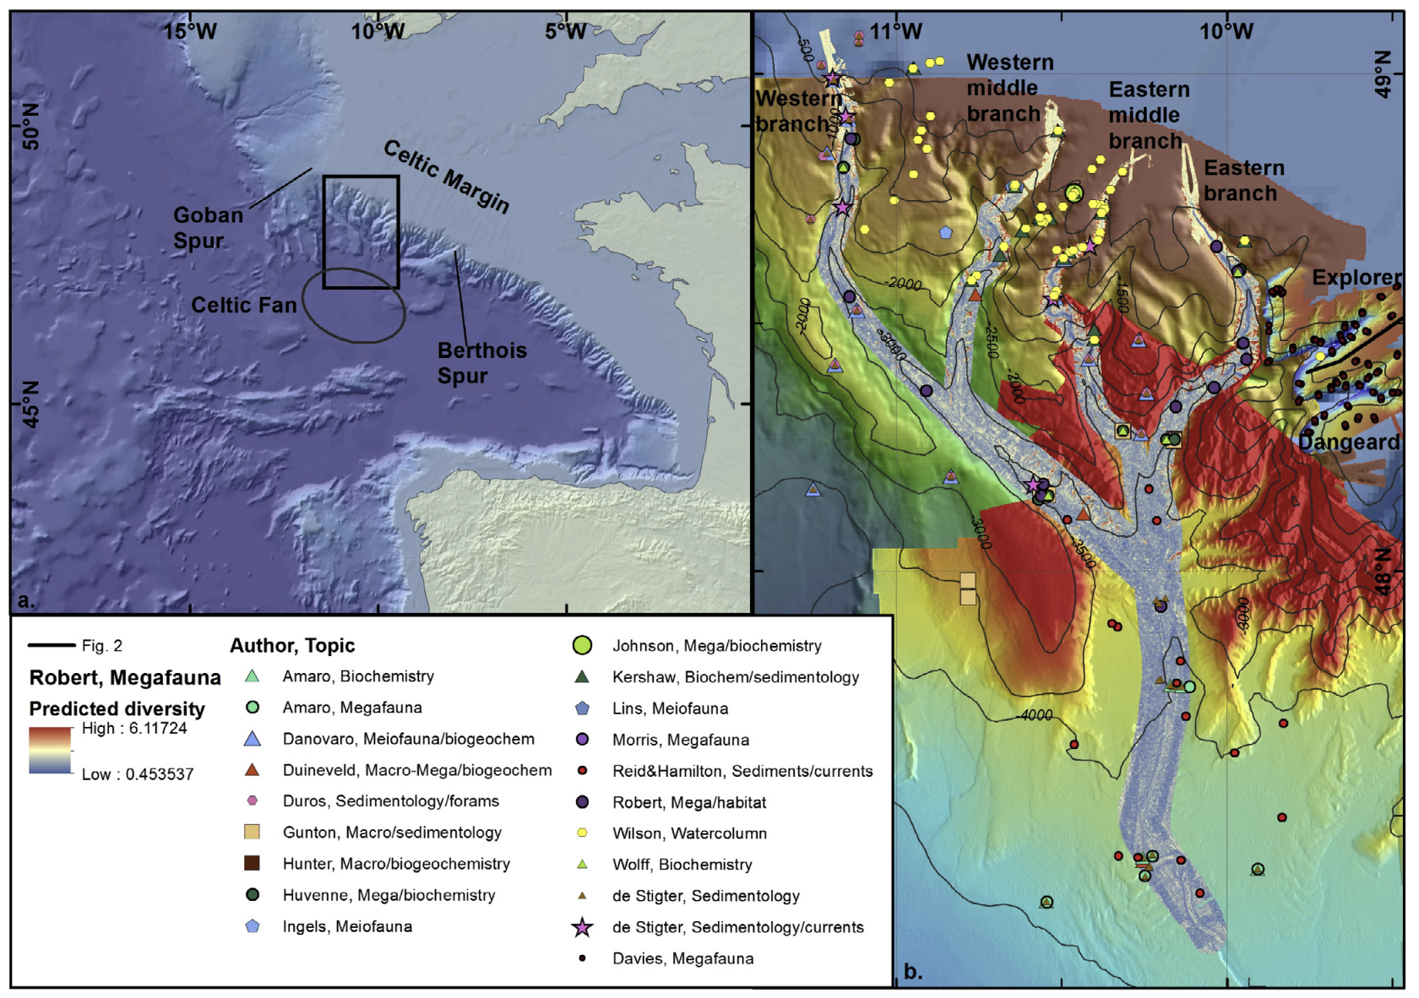
Whittard Canyon
Located in NE Atlantic on the Celtic Margin, 300 km from land
Decades of research into the oceanography and biology of the canyon
Recent research has shown that the canyon is active at present even though it is land-detached
The sedimentology and stratigraphy of the canyon remained relatively understudied…
Amaro et al. 2016

Slide 7
Core data

Slide 8
Whittard Canyon
4 main core methods:
Visual sedimentary descriptions
X-ray scanning
ITRAX XRF scanning (2 mm)
Magnetic susceptibility (5 mm)

Slide 9
Integration

Slide 10
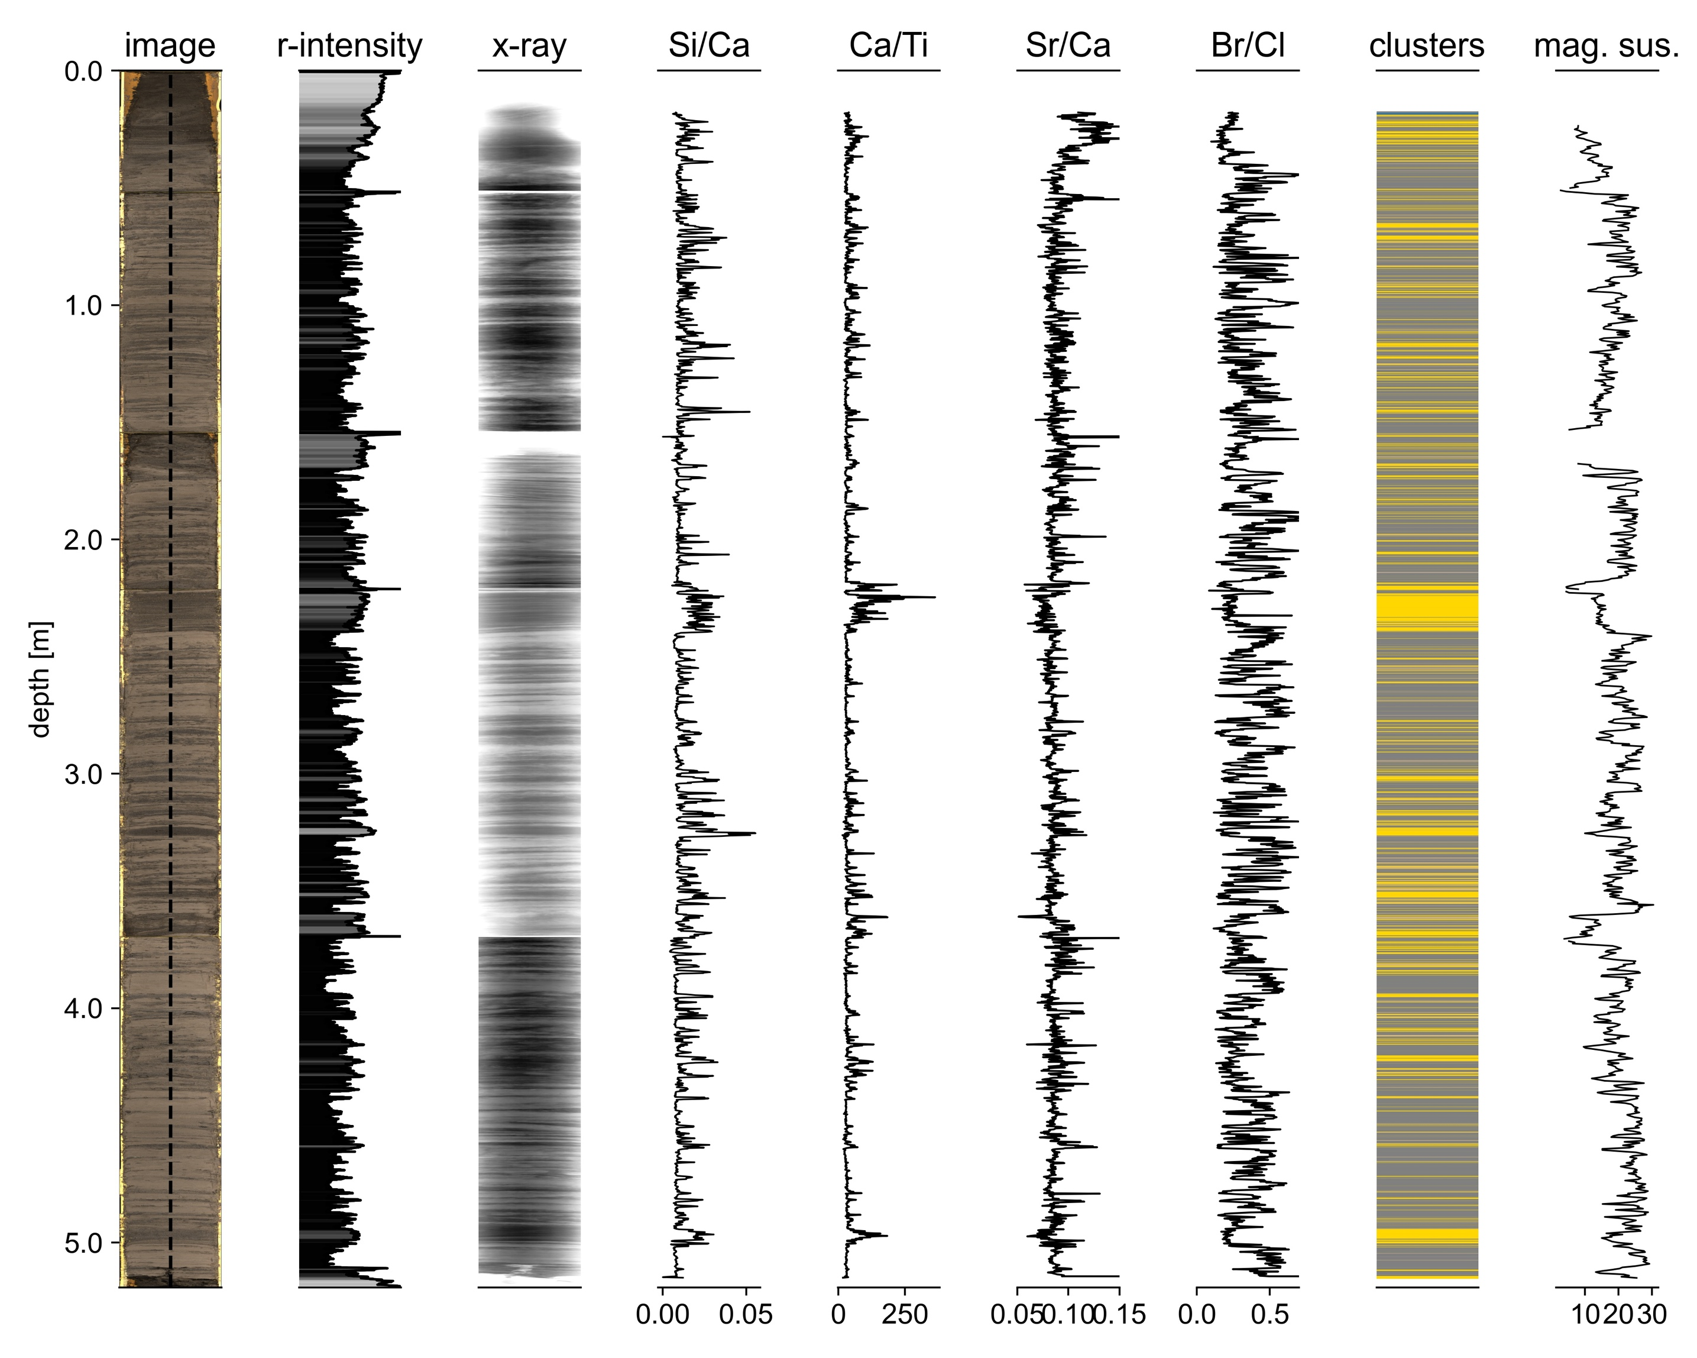

Slide 11
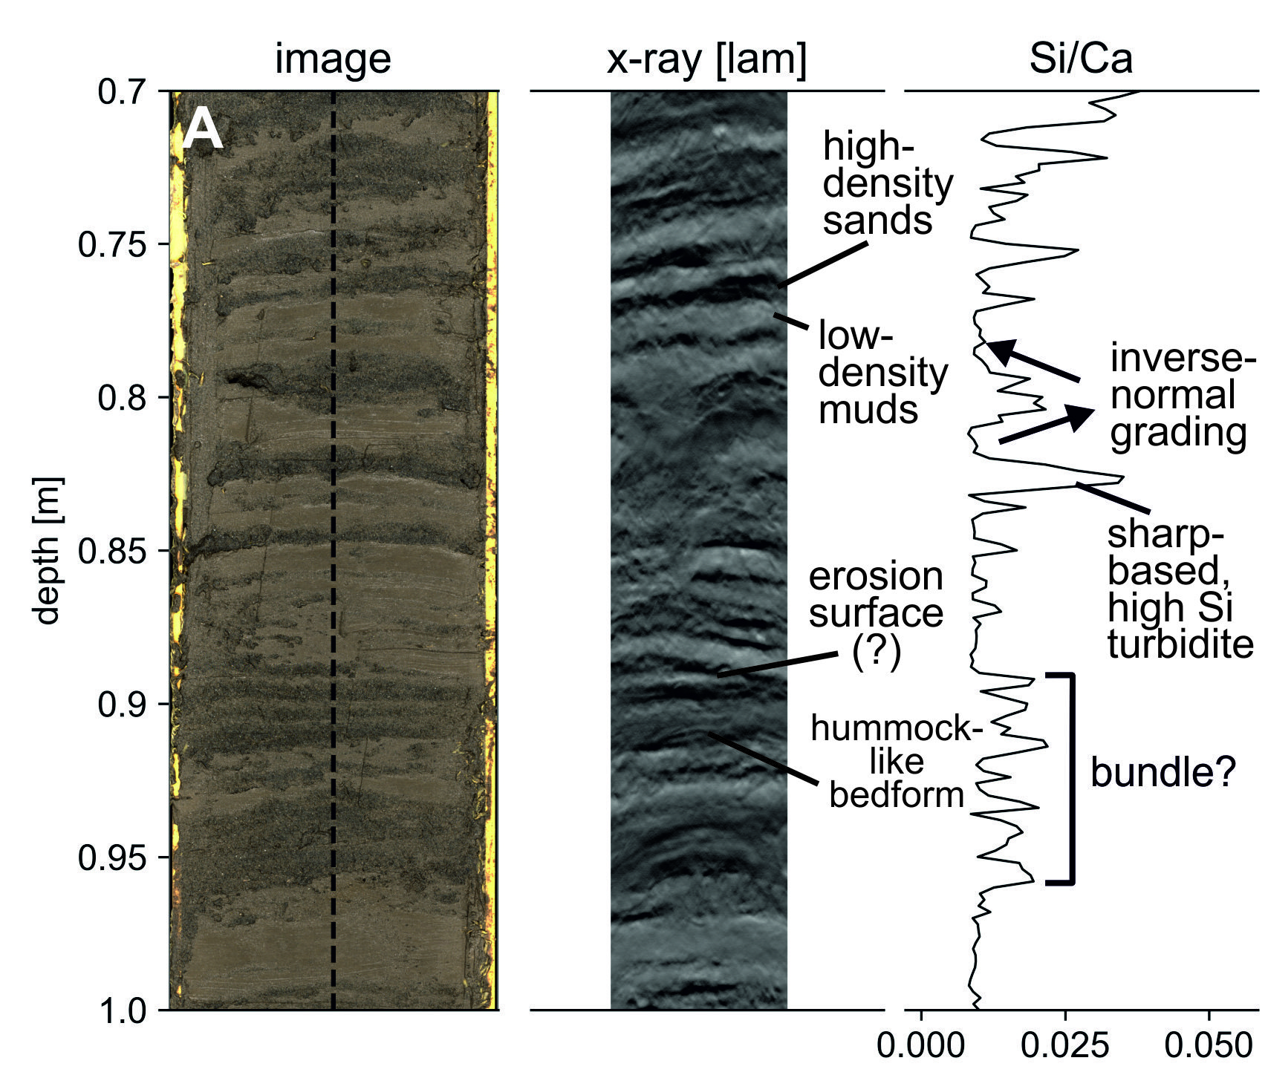
Where were these figures made?

Slide 12
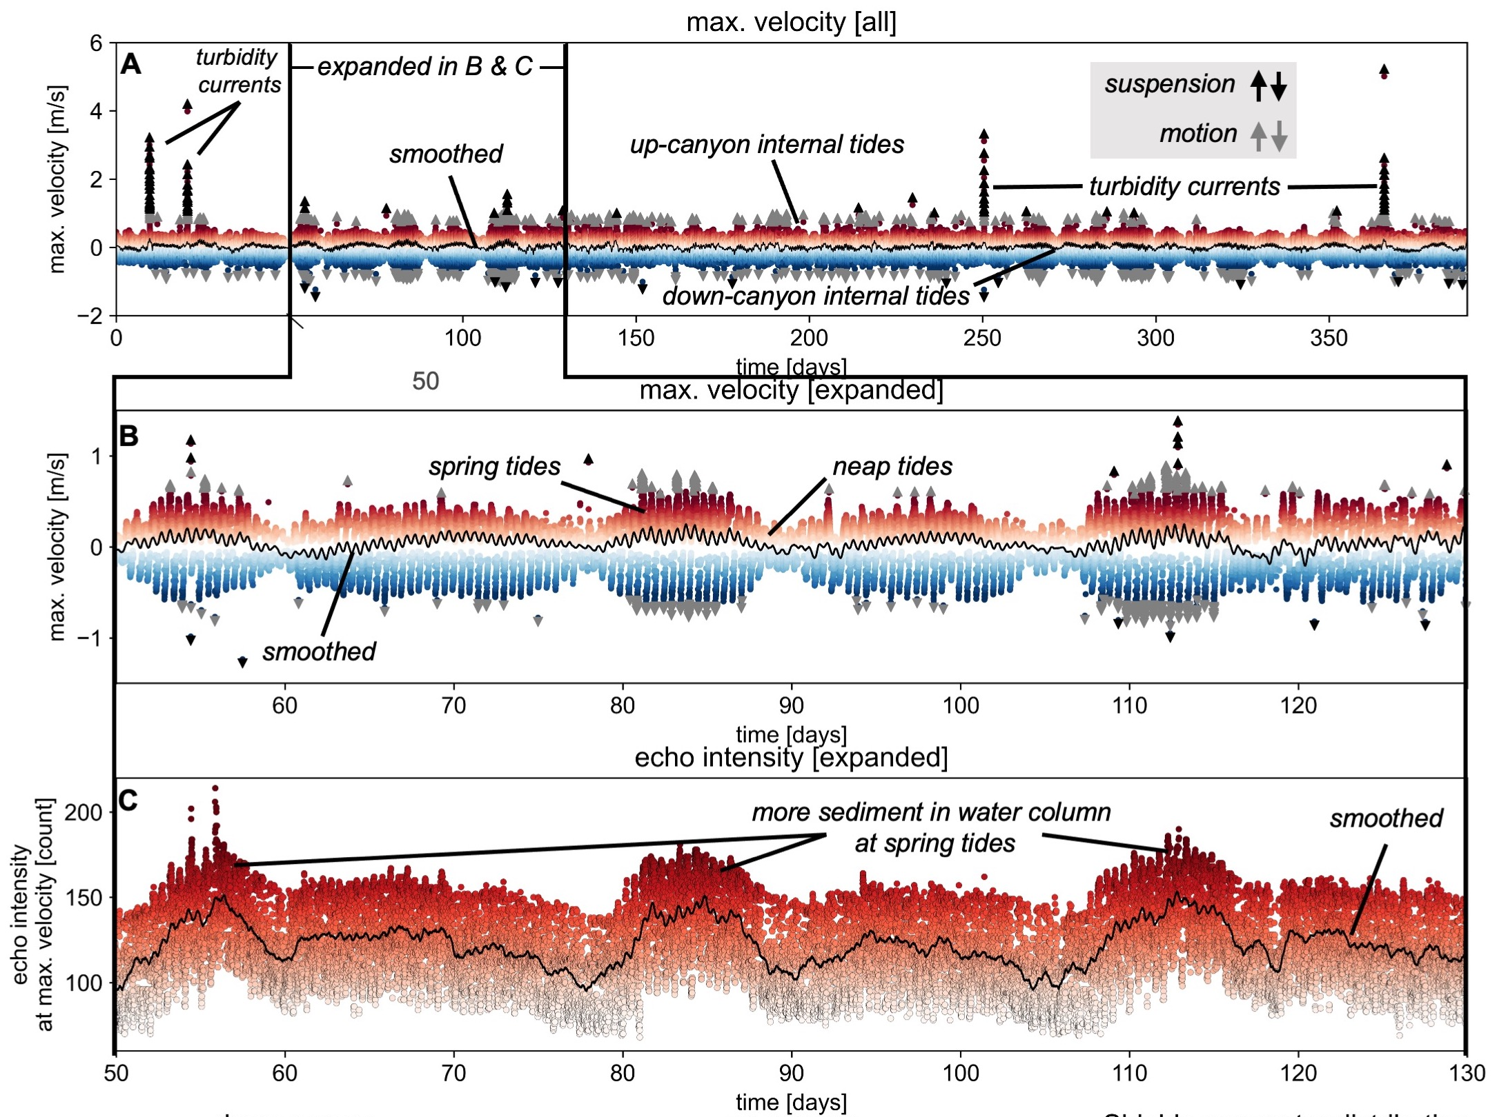

Slide 13
Python

Slide 14
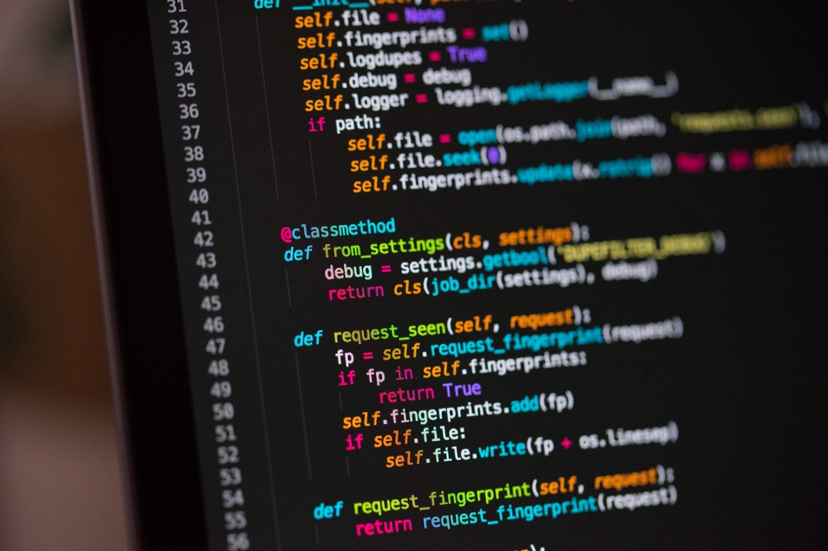



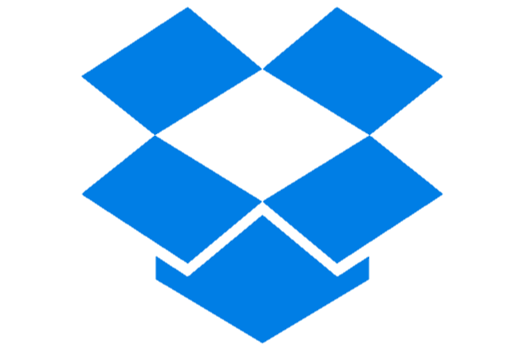

What is Python?
Programming language released in 1991
Named after Monty Python
Most popular language in the world, ahead of C and Java (Sept. 2022)
Builds many websites and software
e.g. Netflix, Instagram, Facebook
Used heavily across science and engineering

Slide 15
Why use Python?
Free & open-source
Used by lots of people, big community
Reproducible research
Relatively ‘readable’
Gives you flexibility to test and present ideas
Useful for almost all careers now e.g. academia, data science, engineering, finance, marketing, government, GIS

Slide 16
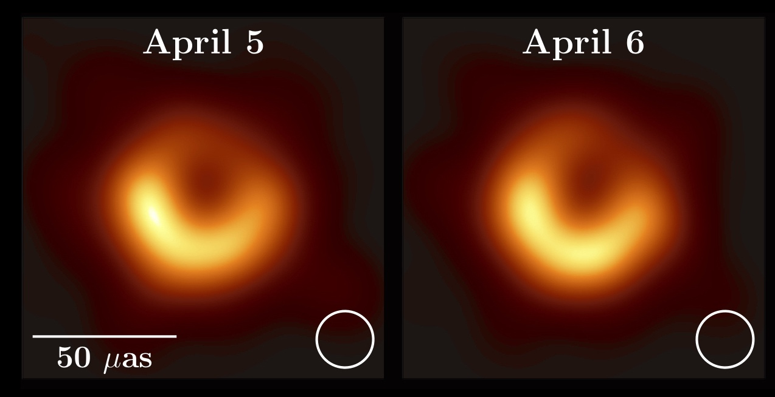
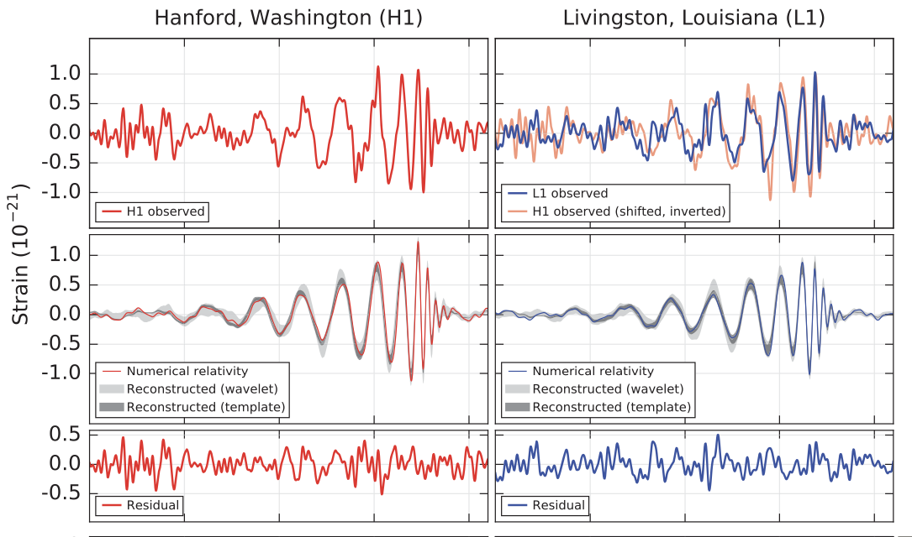
Python in science
Used to image the first black hole…
and the code is available here: https://github.com/achael/eht-imaging
Used in the discovery of gravitational waves
Modelling basin margin progradation in response to climate change
Akiyama, et al. 2019
Abbott, et al. 2016

Slide 17
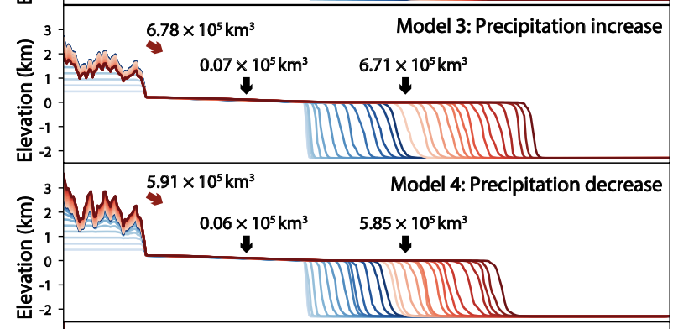
Python in science
Used to image the first black hole…
and the code is available here: https://github.com/achael/eht-imaging
Used in the discovery of gravitational waves
Modelling sedimentation in response to climate change
we’ll use this package today
Akiyama, et al. 2019
Zhang, et al. 2018

Slide 18
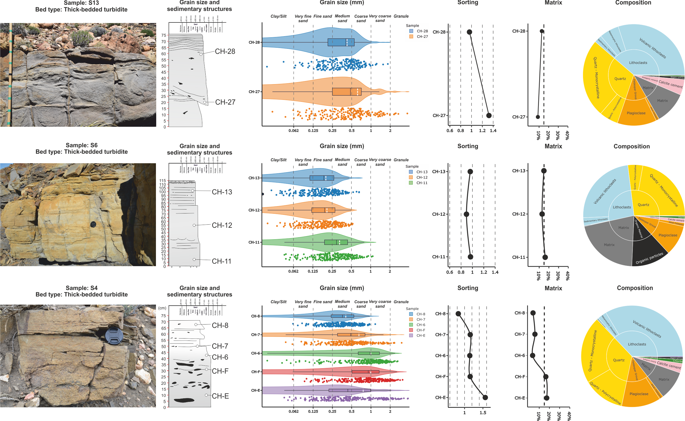
Python in sedimentology
Where are these figures made?
Martinez-Donate, 2021

Slide 19
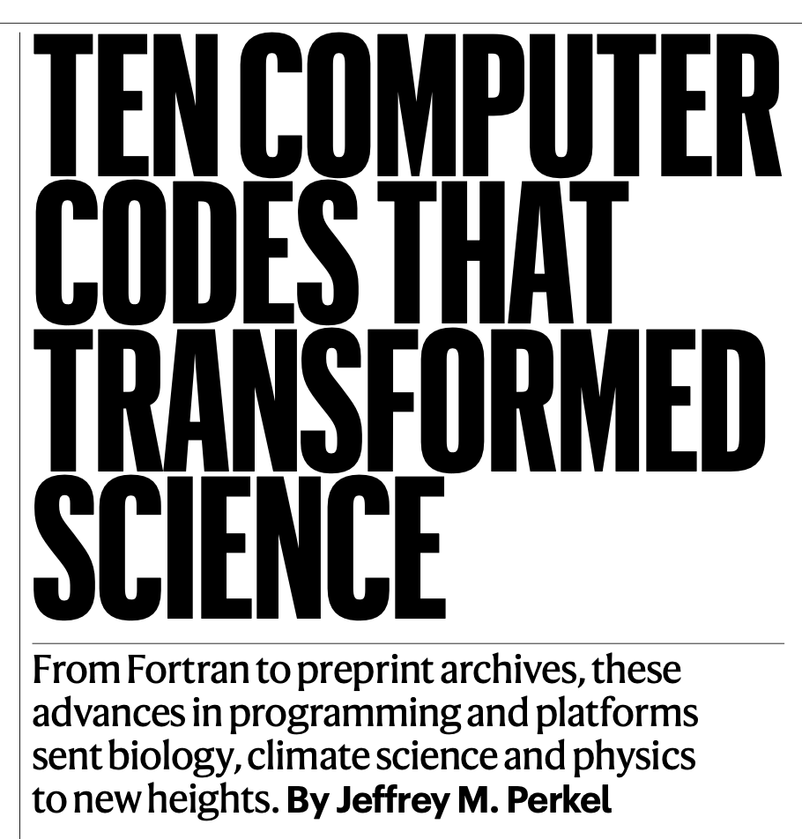
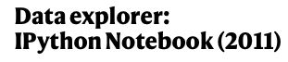
Jupyter Notebooks
Jupyter Notebooks are like an Excel worksheets, but for Python
Often used in science because you can share the notebook easily and add text to your code
10 million notebooks currently on Github
Used to process data that imaged first black hole and discovered gravitational waves
This is what we will use today
Nature, 2021

Slide 20
Tips before we jump in
Don’t be afraid of errors
Don’t be afraid to Google everything, you will forget things
Don’t worry about taking a long time to understand concepts, the time investment is worth it
Just keep practicing and eventually it will click
It’s much easier to practice with your own data e.g. I want to plot my grain size data

Slide 21
Open “Launch Binder” link at:
https://github.com/eslrgs/boscode

Slide 22



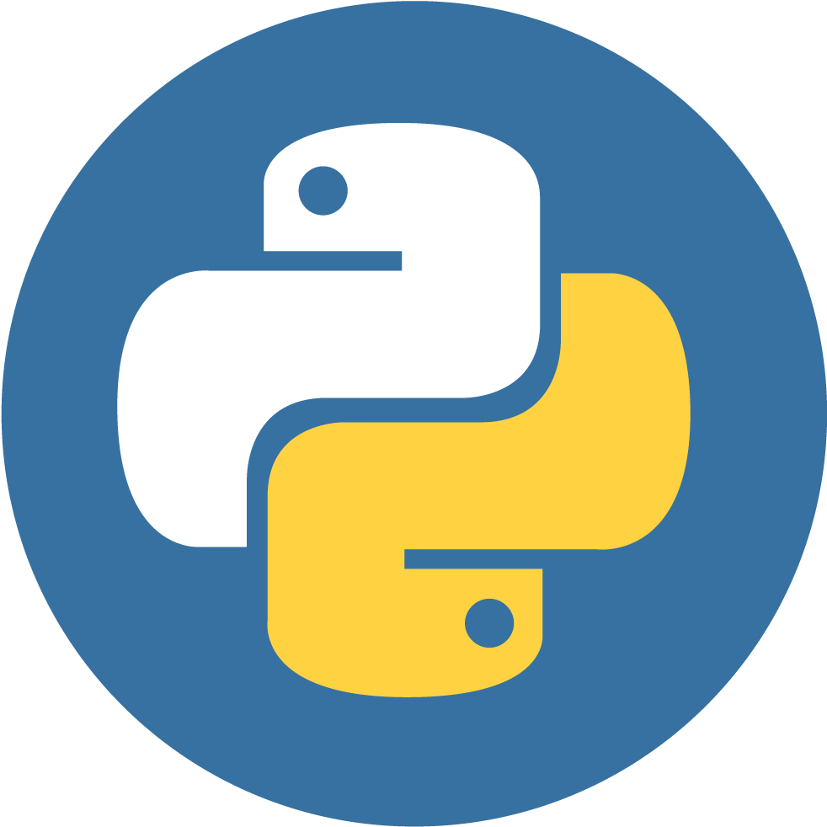
x = ‘hello’ say x
*
In
*
Out
hello

Slide 23

2+2?
*
In
*
Out
4

